Slide 1
Introduction

Slide 2
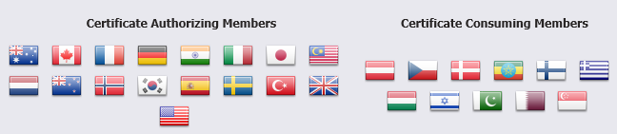
Common Criteria
The Common Criteria for Information Technology Security Evaluation (CC), and the companion Common Methodology for Information Technology Security Evaluation (CEM) are the technical basis for an international agreement, the Common Criteria Recognition Arrangement (CCRA)

Slide 3
Purpose of the Arrangement
1. to ensure that evaluations of Information Technology (IT) products and protection profiles are performed to high and consistent standards and are seen to contribute significantly to confidence in the security of those products and profiles;
2. to improve the availability of evaluated, security-enhanced IT products and protection profiles;
3. to eliminate the burden of duplicating evaluations of IT products and protection profiles;
4. to continuously improve the efficiency and cost-effectiveness of the evaluation and certification/validation* process for IT products and protection profiles.

Slide 4
The International Common Criteria Standard ( ISO/IEC 15408)
What the standard is –
Common structure and language for expressing product/system IT security requirements (Part 1)
Catalog of standardized IT security requirement components and packages (Parts 2 and 3)
How the standard is used –
Develop protection profiles and security targets -- specific IT security requirements and specifications for products and systems
Evaluate products and systems against known and understood IT security requirements

Slide 5
An Evolutionary Process
Two decades of research and development…
Common
Criteria
1993-98
US-NIST
MSFR
1990
Federal
Criteria
1992
US-DOD
TCSEC
1983-85
Canada
TCPEC
1993
ISO 15408
Common
Criteria
1999
European National/Regional Initiatives
1989-93
Europe
ITSEC
1991
Canadian Initiatives
1989-93

Slide 6
IT Security Requirements
The Common Criteria defines two types of IT security requirements--
Functional Requirements
- for defining security behavior
of the IT product or system:
implemented requirements
become security functions
Assurance Requirements
- for establishing confidence in security functions:
correctness of implementation
effectiveness in satisfying security objectives
Examples:
Identification & Authentication
Audit
User Data Protection
Cryptographic Support
Examples:
Development
Configuration Management
Life Cycle Support
Testing
Vulnerability Analysis

Slide 7
Evaluation Assurance Levels
Common Criteria defines seven hierarchical assurance levels--
EAL1
EAL2
EAL3
EAL4
EAL5
EAL6
EAL7
EAL Designation
Functionally Tested
Structurally Tested
Methodically Tested & Checked
Methodically Designed, Tested & Reviewed
Semiformally Designed & Tested
Semiformally Verified Design & Tested
Formally Verified Design & Tested

Slide 8
Protection Profiles (generic) & Security Targets (specific)
Protection Profile contents
Introduction
TOE Description
Security Environment
Assumptions
Threats
Organizational security policies
Security Objectives
Security Requirements
Functional requirements
Assurance requirements
Rationale
Security Target contents
Introduction
TOE Description
Security Environment
Assumptions
Threats
Organizational security policies
Security Objectives
Security Requirements
Functional requirements
Assurance requirements
TOE Summary Specification
PP Claims
Rationale

Slide 9
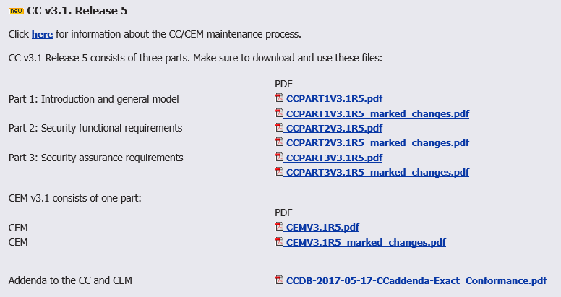
CC/CEM

Slide 10
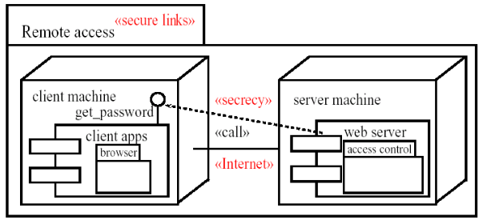
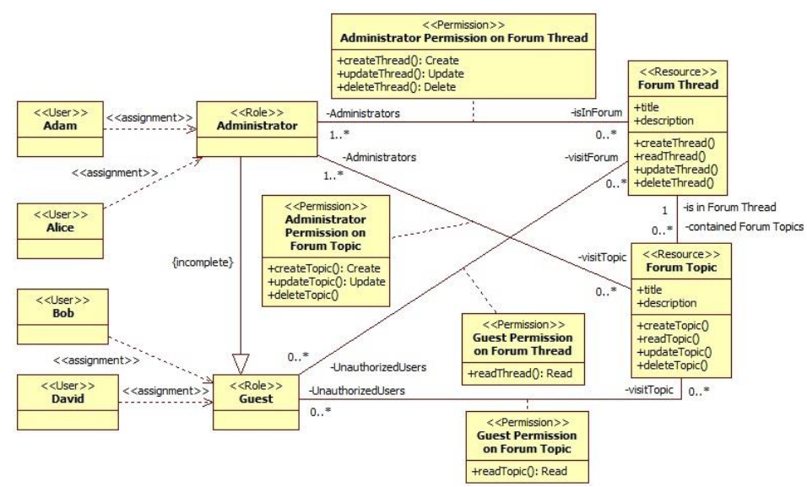
Security oriented UML
SecureUML, UMLsec, etc.

Slide 11

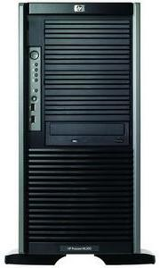
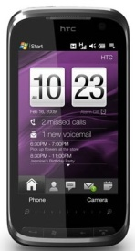

myBlackBox System Design
Unusual event: screaming and immobilized user
Cloud Server
Smartphone
Family or User

Slide 12
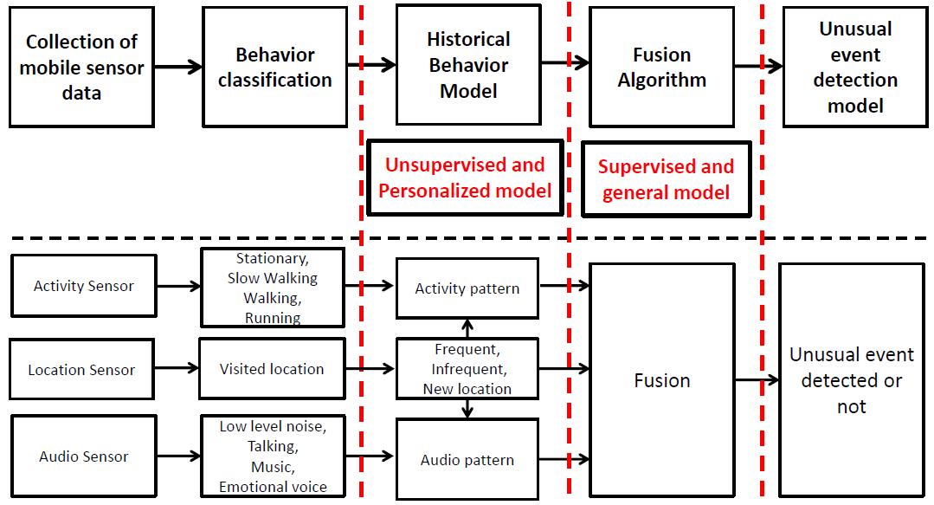
myBlackBox Algorithm Design

Slide 13
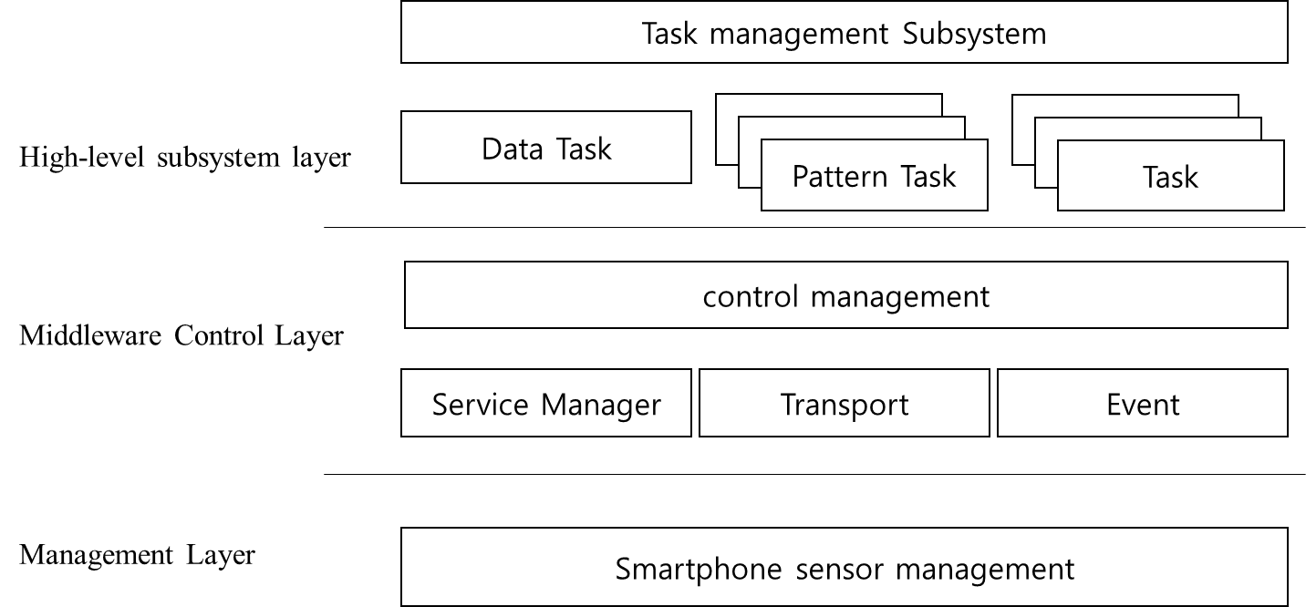
Three-layered Architecture

Slide 14
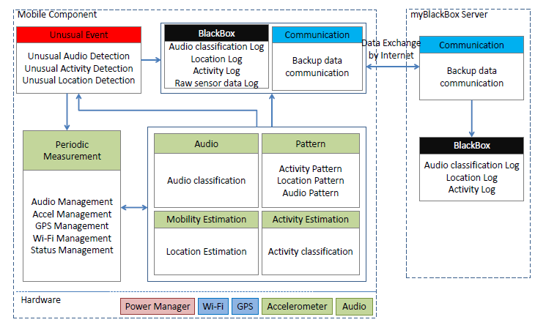
IoT AI Cloud Architecture

Slide 15
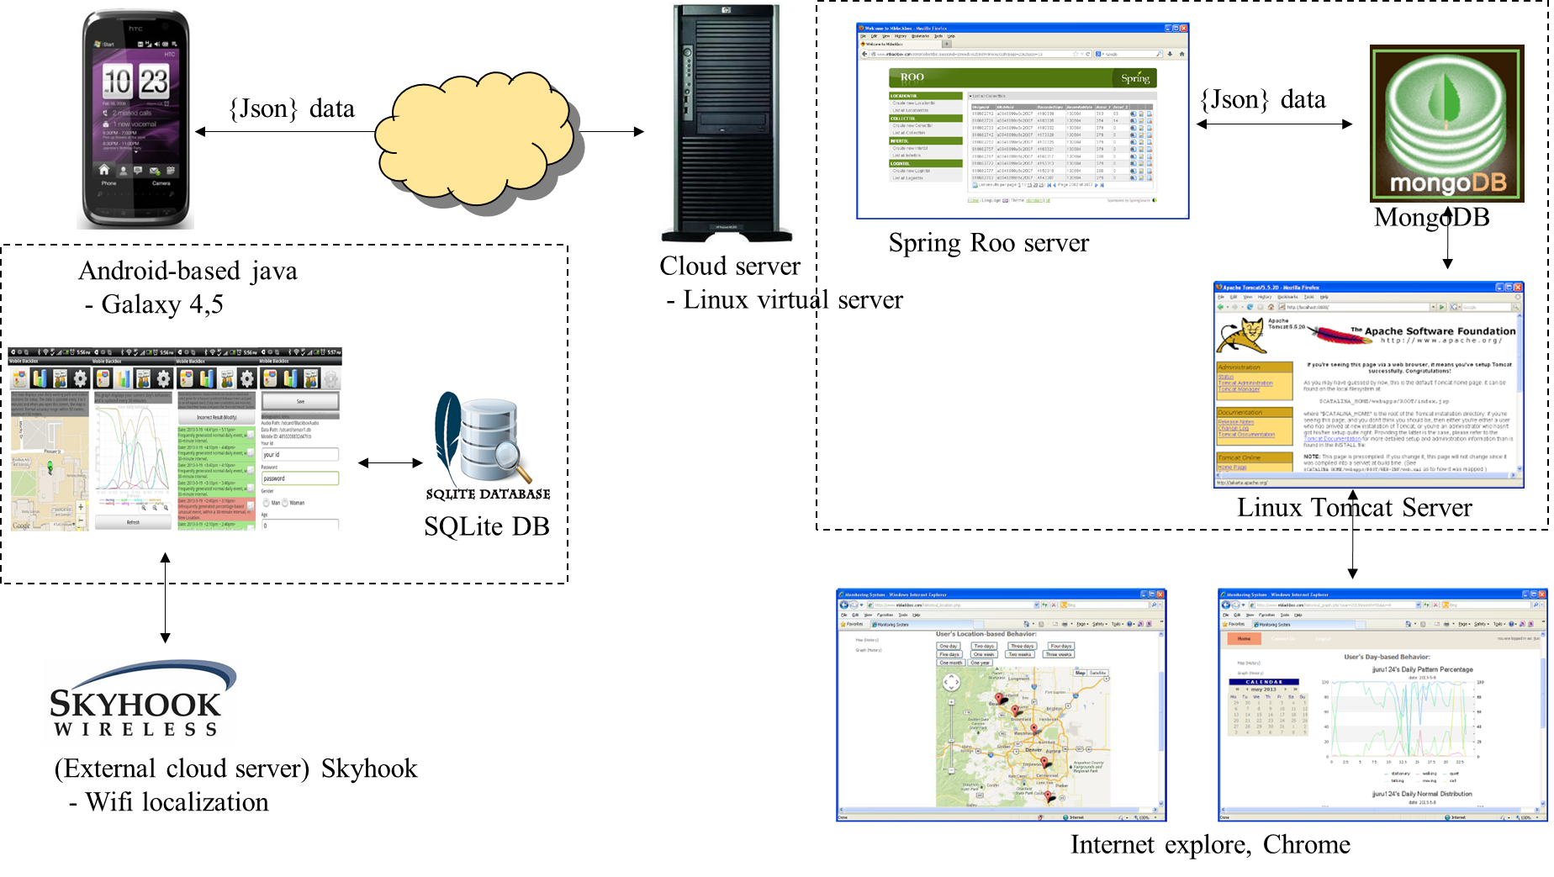
IoT AI Cloud Physical Scope

Slide 16
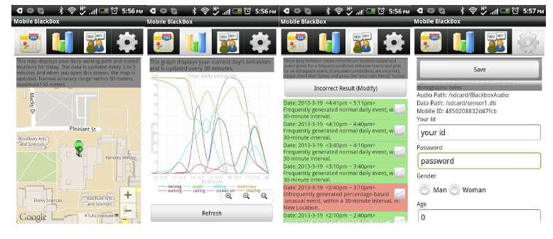
End to End myBlackBox Application
Mobile application
Background service
UI and functionality (four screens)
Location view
Pattern graph view
Unusual event detection view
Login info

Slide 17
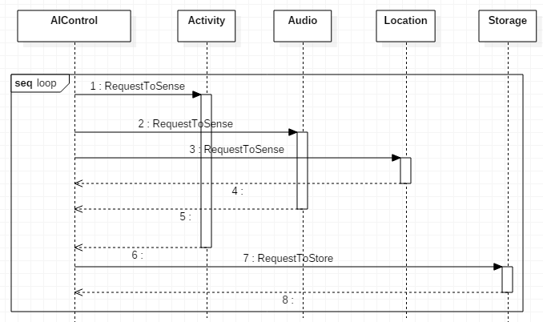
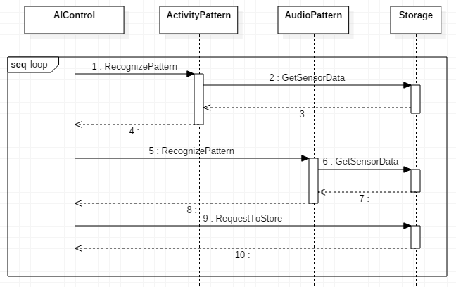
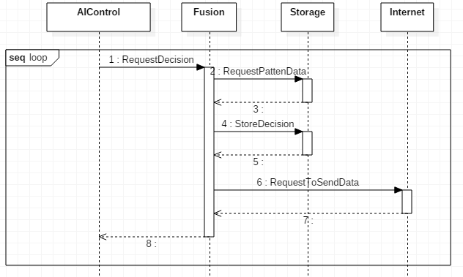
IoT AI Sequence diagram

Slide 18
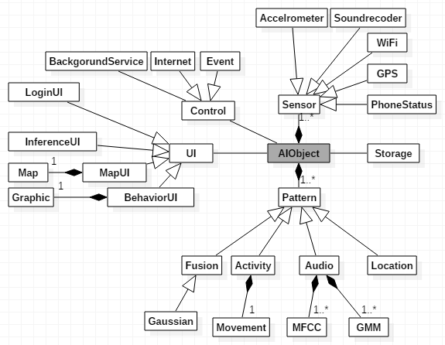
IoT AI Cloud model

